Slide 1
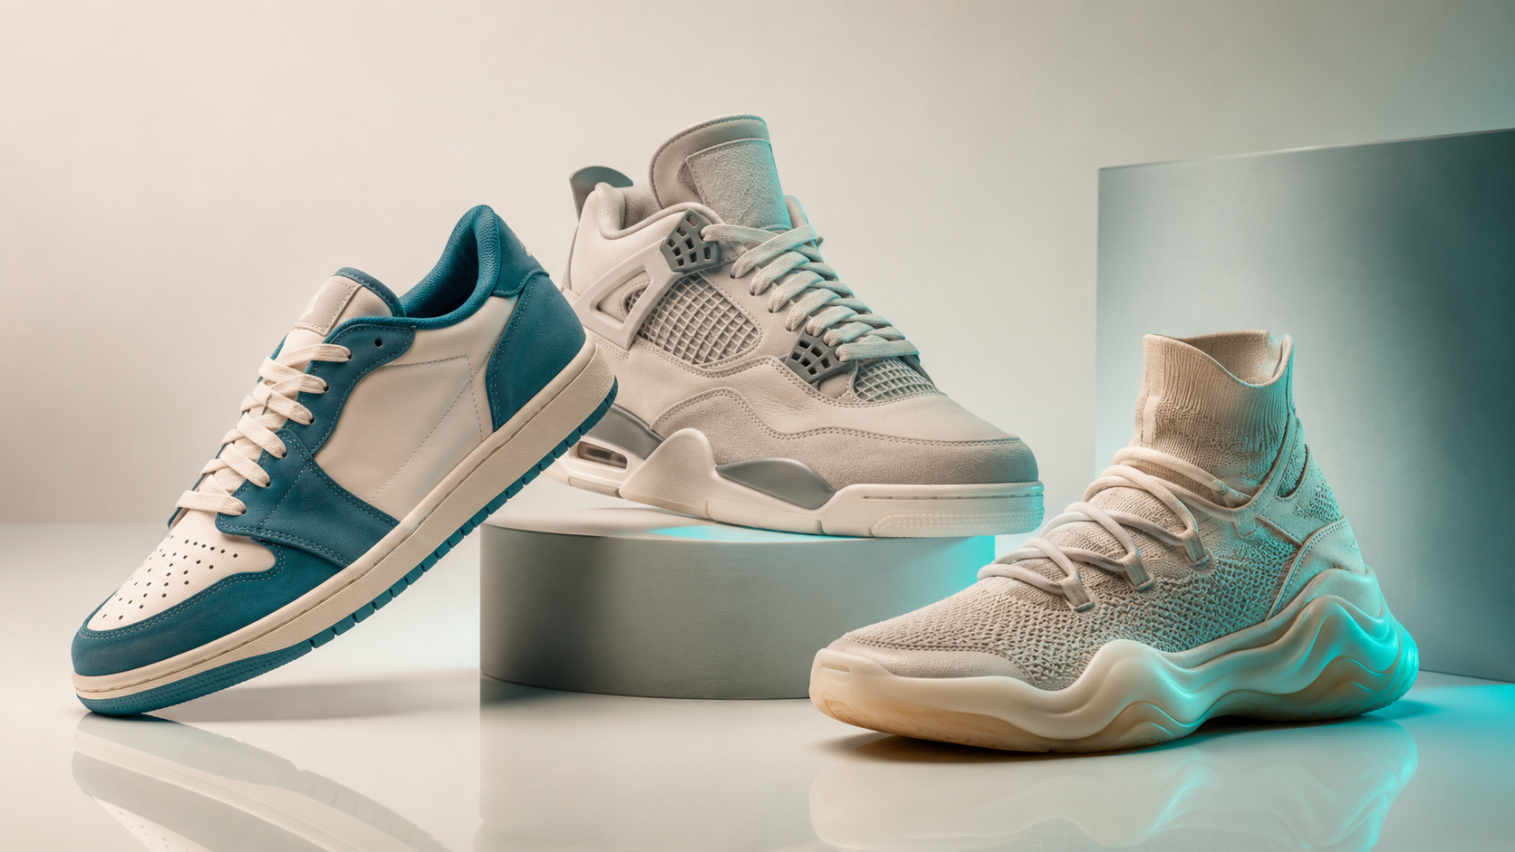
OpenCart Development
E-Commerce SEO
CRM Integration
gkit
OpenCart Store Build
+ SEO Launch Strategy
Full-cycle project: from mock-up audit and CRM architecture to technical SEO and analytics — launching a branded fashion e-commerce store primed for growth.
gkit.com.ua · OpenCart + KeepinCRM · Fashion & Sportswear
85
58.82%
2,600
42
Organic Sessions
(Month 1)
Engagement
Rate
Search
Impressions
Organic
Clicks

Slide 2
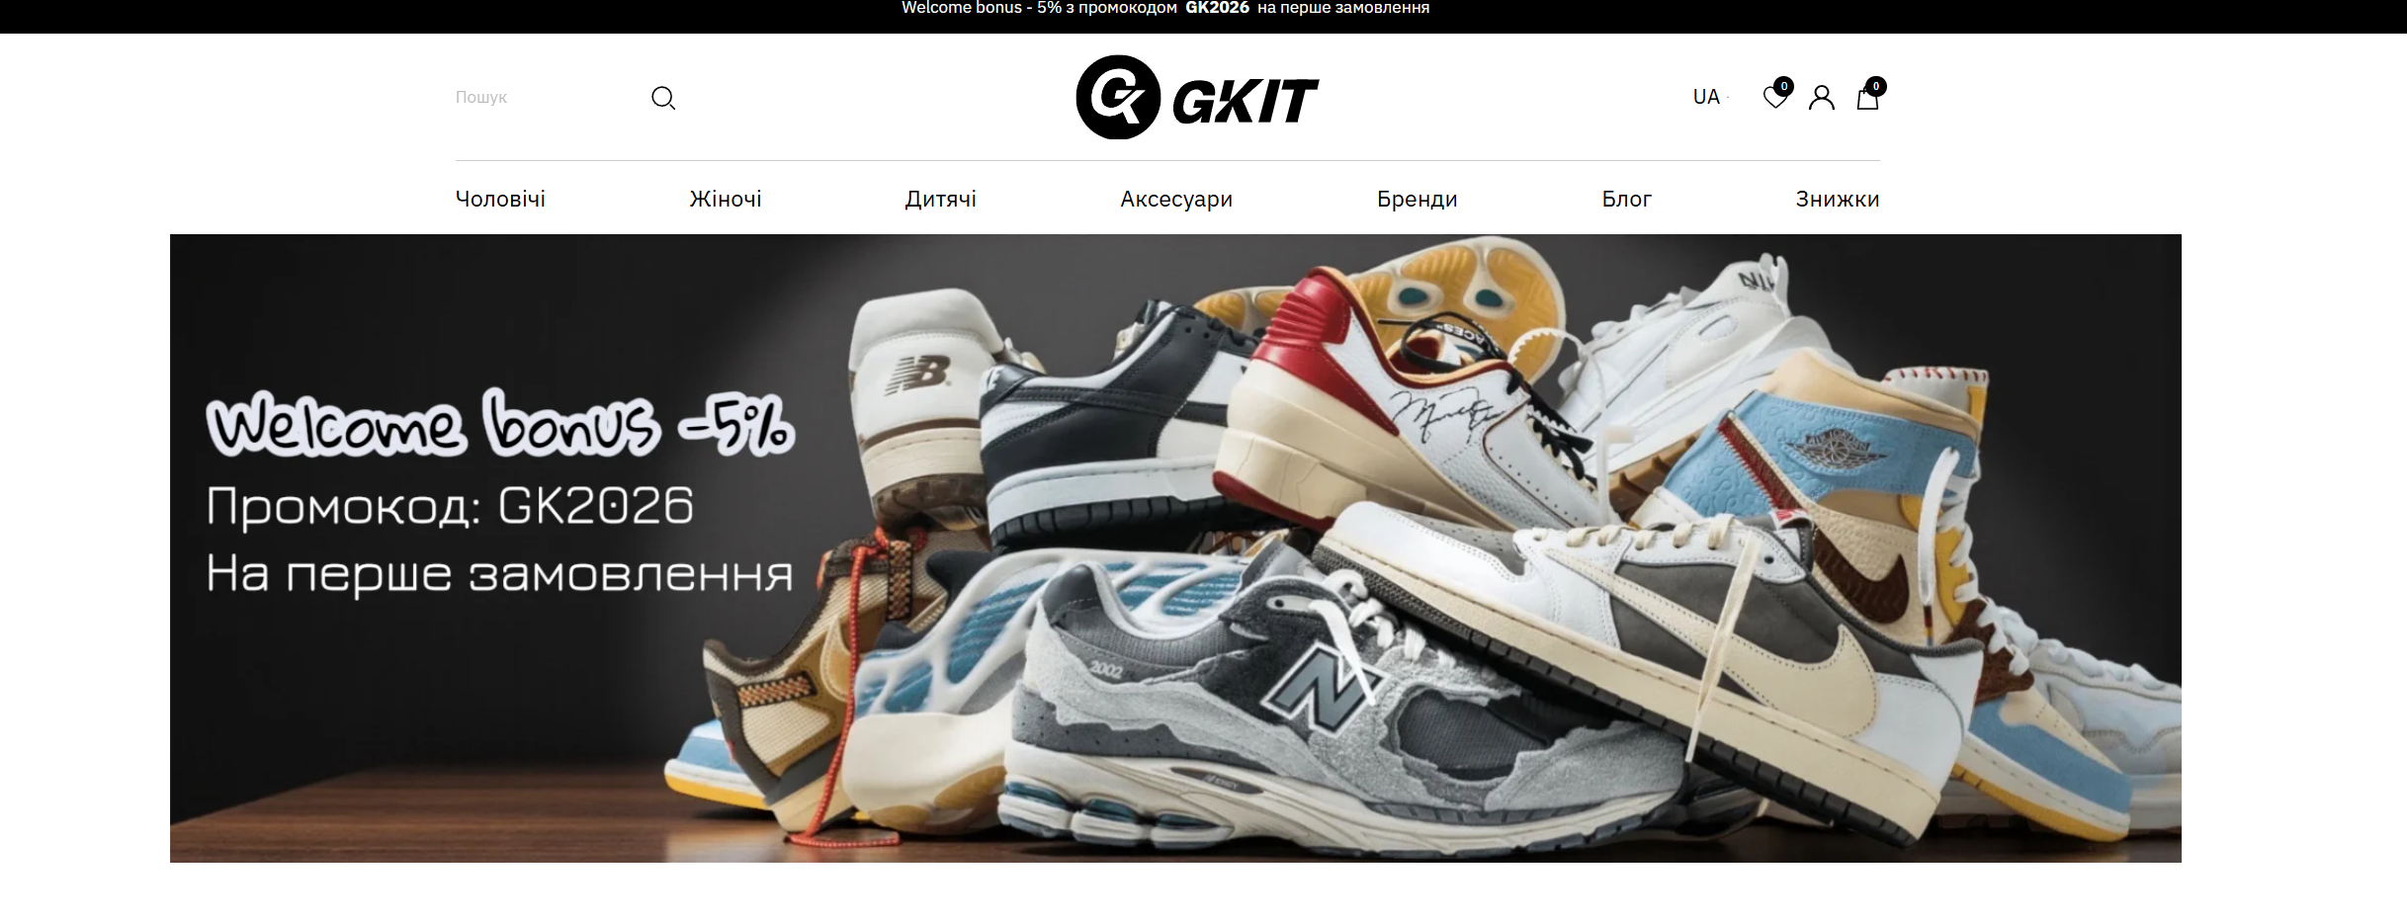
CLIENT OVERVIEW
GKit — Premium Branded Fashion Store
Online destination for original Nike, Adidas, Jordan & New Balance — built on OpenCart
STORE
gkit.com.ua
GKit (gkit.com.ua) — premium branded clothing, footwear & accessories. Works exclusively with verified suppliers. No replicas.
MARKET
Multi-brand retail. Delivery nationwide. Payments: Privat24, Monopay, Visa/Mastercard.
PLATFORM
OpenCart CMS with KeepinCRM integration for inventory & order management.
TASK
Full website development from mock-up stage, followed by SEO launch & first-month growth.
Industry: E-Commerce · Fashion & Sportswear · Multi-Brand Retail | Project Type: Web Development + SEO

Slide 3
THE CHALLENGE
Building on a Glass Foundation
A new store, a complex catalog, and zero organic history — every decision had to be right from day one.
No Organic History
Duplicate SKU Crisis
CRM Sync Architecture
Brand-new domain with zero SEO signals, no backlinks, and no indexed pages. Every ranking had to be earned from scratch.
Each shoe size was stored as a separate product — 100 models x 5 sizes = 500 separate listings. Disastrous for UX and SEO.
Client needed KeepinCRM to control inventory with automatic sync to OpenCart — a bidirectional data flow requiring careful design.
Bilingual Catalog
SEO-Integrated Development
No Existing Analytics
All product data, filters, and metadata needed in both Ukrainian and Russian — with standardized dropdowns, not free-text entry.
Technical SEO requirements (hreflang, canonical, Schema.org, URL structure) had to be baked in during build, not retrofitted post-launch.
GA4, GTM, and GSC all had to be configured from scratch with a fully working ecommerce tracking layer before first traffic arrived.
Every challenge was addressed before launch. The result: a site that ranked from day one.

Slide 4
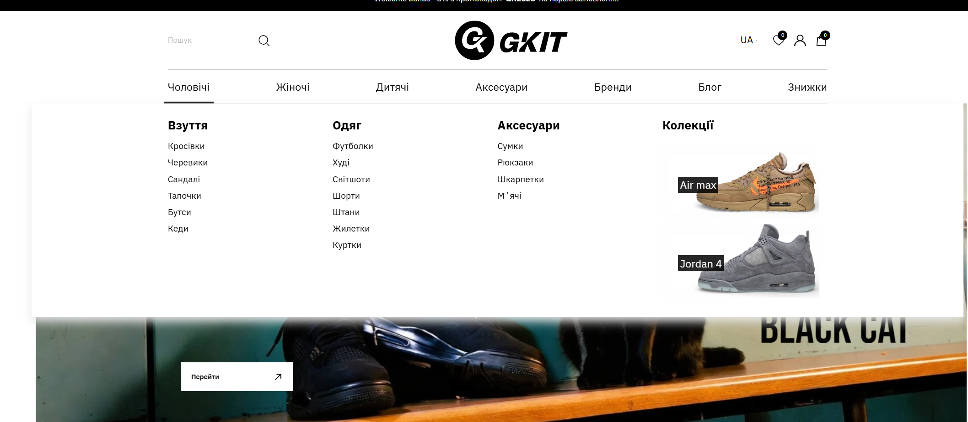
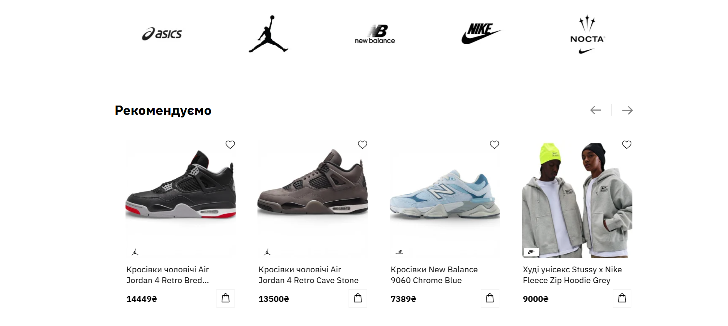
PHASE 1 · DEVELOPMENT
OpenCart Build & UI Architecture
Full development from mockup audit through CRM-ready structure
Mock-up Audit
gkit.com.ua
Analysed design files before a single line of code was written. Identified structural issues, missing UI states, and device responsiveness gaps.
GKIT | Men Women Kids Accessories Brands
Home / Footwear / Men's Sneakers
Men's Sneakers
UI Gap Fixes
Added missing language switcher dropdown, cart/wishlist item counters in the header, and a product review form on product pages.
UX Restructure
Proposed 3-column review grid, product images in review listings, and moved the "Add Review" action to product cards only.
Variant Architecture
Redesigned product data model: 5 separate size SKUs -> 1 parent card with size/color as modifications. Eliminated catalog bloat.
Result: clean architecture, SEO-ready from the first commit.

Slide 5
PHASE 2 · CRM INTEGRATION
KeepinCRM <-> OpenCart Architecture
Designing bidirectional data flow so the CRM is the single source of truth
KeepinCRM
Product sync
(CRM -> Site)
OpenCart
Customer
Inventory · Pricing
Product data
Storefront
Product pages
Browse · Cart
Checkout
Orders
(Site -> CRM)
Parent + Variations
Sync Marker
One product card per model. Sizes & colors as OpenCart modifications — eliminating 80%+ of duplicate SKUs.
Each CRM product has an "Update to site?" toggle. Changes only push when the manager explicitly enables sync.
Field Standardisation
CDN for Media
All filter attributes (Type, Season, Collection, Purpose) use dropdown fields — preventing free-text typos from creating garbage filters.
Product images stored on CDN (bunny.net). CRM stores URLs only. Browser fetches images from nearest edge node.
CRM as the single source of truth — inventory, pricing, and product data flow automatically to the storefront.

Slide 6
PHASE 3 · TECHNICAL SEO
SEO-Ready Architecture, Built Before Launch
Technical audit delivered before go-live, not as a post-launch patch
SSL & HTTPS
hreflang Tags
HTTPS enforced with 301 redirect from HTTP on every URL. Prerequisite for all crawling and ranking.
Ukrainian (uk) and Russian (ru) versions linked with correct x-default. No duplicate content penalty.
URL Structure
Schema.org Markup
Hyphenated slugs, no Cyrillic, consistent trailing slashes. Filter URLs use human-readable format.
Product, BreadcrumbList, and Organization types implemented. Rich snippets ready on day one.
Canonicals & Indexation
Image Optimisation
Filter pages use canonical to parent category. Cart, checkout, and search results marked noindex.
WebP format, lazy loading, descriptive ALT attributes. All product images optimised at import.
Competitor Analysis
Sitemap & Robots.txt
4 key competitors mapped (yesoriginal, allstars, answear, prm). Link strategy and filter indexation logic derived from their best practices.
Sitemap generated post-launch. Robots.txt configured to allow crawling of all indexed pages and block all tech pages.
Full tech audit completed before release. Zero technical debt handed to the organic channel.

Slide 7
PHASE 4 · ANALYTICS
Full Measurement Stack — Configured Before First Visit
GA4 + GTM + GSC implemented, tested, and verified. Ecommerce tracking live on launch day.
GA4
Google Analytics 4
GTM
Google Tag Manager
GSC
Google Search Console
Data stream configured with measurement ID
Container installed across all site pages
Property verified via HTML file upload
Ecommerce module: product impressions, add-to-cart, purchases
All marketing tags managed without developer intervention
Sitemap submitted post-launch
First test transactions recorded in GA4 before go-live
Ecommerce data layer structured for GA4 events
Indexed coverage tracked from day 1
Ecommerce transactions recording in GA4 GSC ownership verified GTM container optimised
Measurement-first approach — every click, session, and conversion tracked from launch.

Slide 8
RESULTS
Month 1 Organic Performance
March 2026 — first full month after launch. All data from Google Search Console & GA4.
2,600
42
85
Search
Impressions
Organic
Clicks
Organic
Sessions
1.6%
#24.3
58.82%
Click-Through
Rate (CTR)
Average Search
Position
Session
Engagement Rate
New store ranking page 3 average within weeks of launch — impressions +50x, upward trajectory confirmed.

Slide 9
ITForce
E-Commerce
OpenCart
Built Right.
Launched Right.
Ranking from Day One.
SEO-Integrated Dev
Fashion Retail
Full OpenCart development with SEO-ready architecture from mockup stage
KeepinCRM integration with bidirectional product & order sync
Complete technical SEO: hreflang, Schema.org, canonical, URL rules
GA4 + GTM + GSC configured — ecommerce tracking live on launch day
Position 24.3 average with confirmed upward trend in Month 1
ITForce · itforce.ua · Google Ads Premier Partner · Shopify Partner · 91 Case Studies Published

